Slide 1
Project Title : Online Tutor Finder System
Course Title:Software Engineering and Information System Design
Sumitted To:
Dhrubajyoti Das
Lecturer
Department of Computer Science &amp; Engineering.
Premier University , Chittagong.

Slide 2
Group Members
Israt Jahan Shama(1519) Afroja Sultana Riya(1375) Rashma Dev(1530) (5 TH semester.)

Slide 3
INTRODUCTION
On this we are trying to solve the ongoing problem of
finding tutor and tuition. Day by day, the system of education are
improved and changed instantly. For this reason, good tutors are badly
needed for our society. To solving this problem we are taking a project in
hand which is “Online Tutor Finder”. We are trying to make software so
that one can easily find tutor and an tutor easily find tuition by one search.

Slide 4
Motivation
➢ Our core objectives is to make a communication path between
student and tutor.
➢ Our main focused is to make easiest searching so that one can easily
find tutor or tuition.
➢ We are trying to remove a some problem (e.g. : tuition place,salary
and miscommunication with parents) which are faced badly some
tutor today.
➢ We aim to make it easy for our students to find the teacher by
fulfilling their own needed.

Slide 5
Features
• Public User
1) Search Tutor
2) View Post
3) Create User Account (as tutor or as student)

Slide 6
Features
• Student User
1) Search Tutor
2) Publish Circular
3) Apply for teacher
4) Update student’s details

Slide 7
Technologies Used
• User as Student
1) Find Tuition / Search Tuition
2) View Circular
3) Update Teacher Account and details

Slide 8
Technologies Used
FOR front end : BOOTSTRAP,CSS,JAVASCRIPT,HTML
FOR Back end:
PHP,JAVASCRIPT.

Slide 9
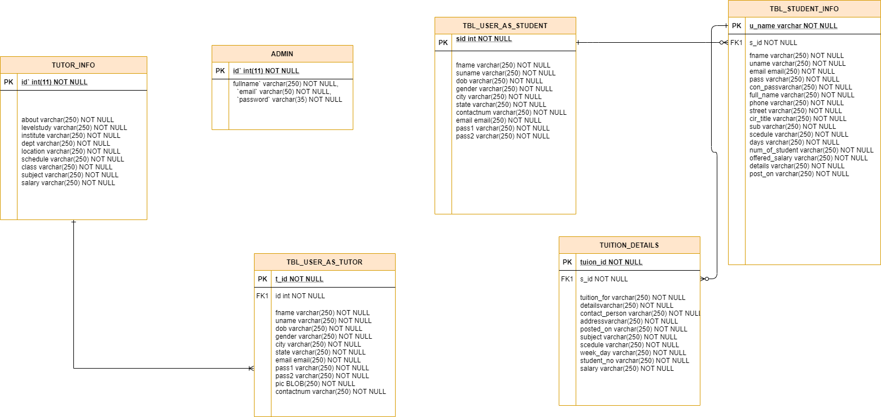
Methodology(ER-diagram)

Slide 10
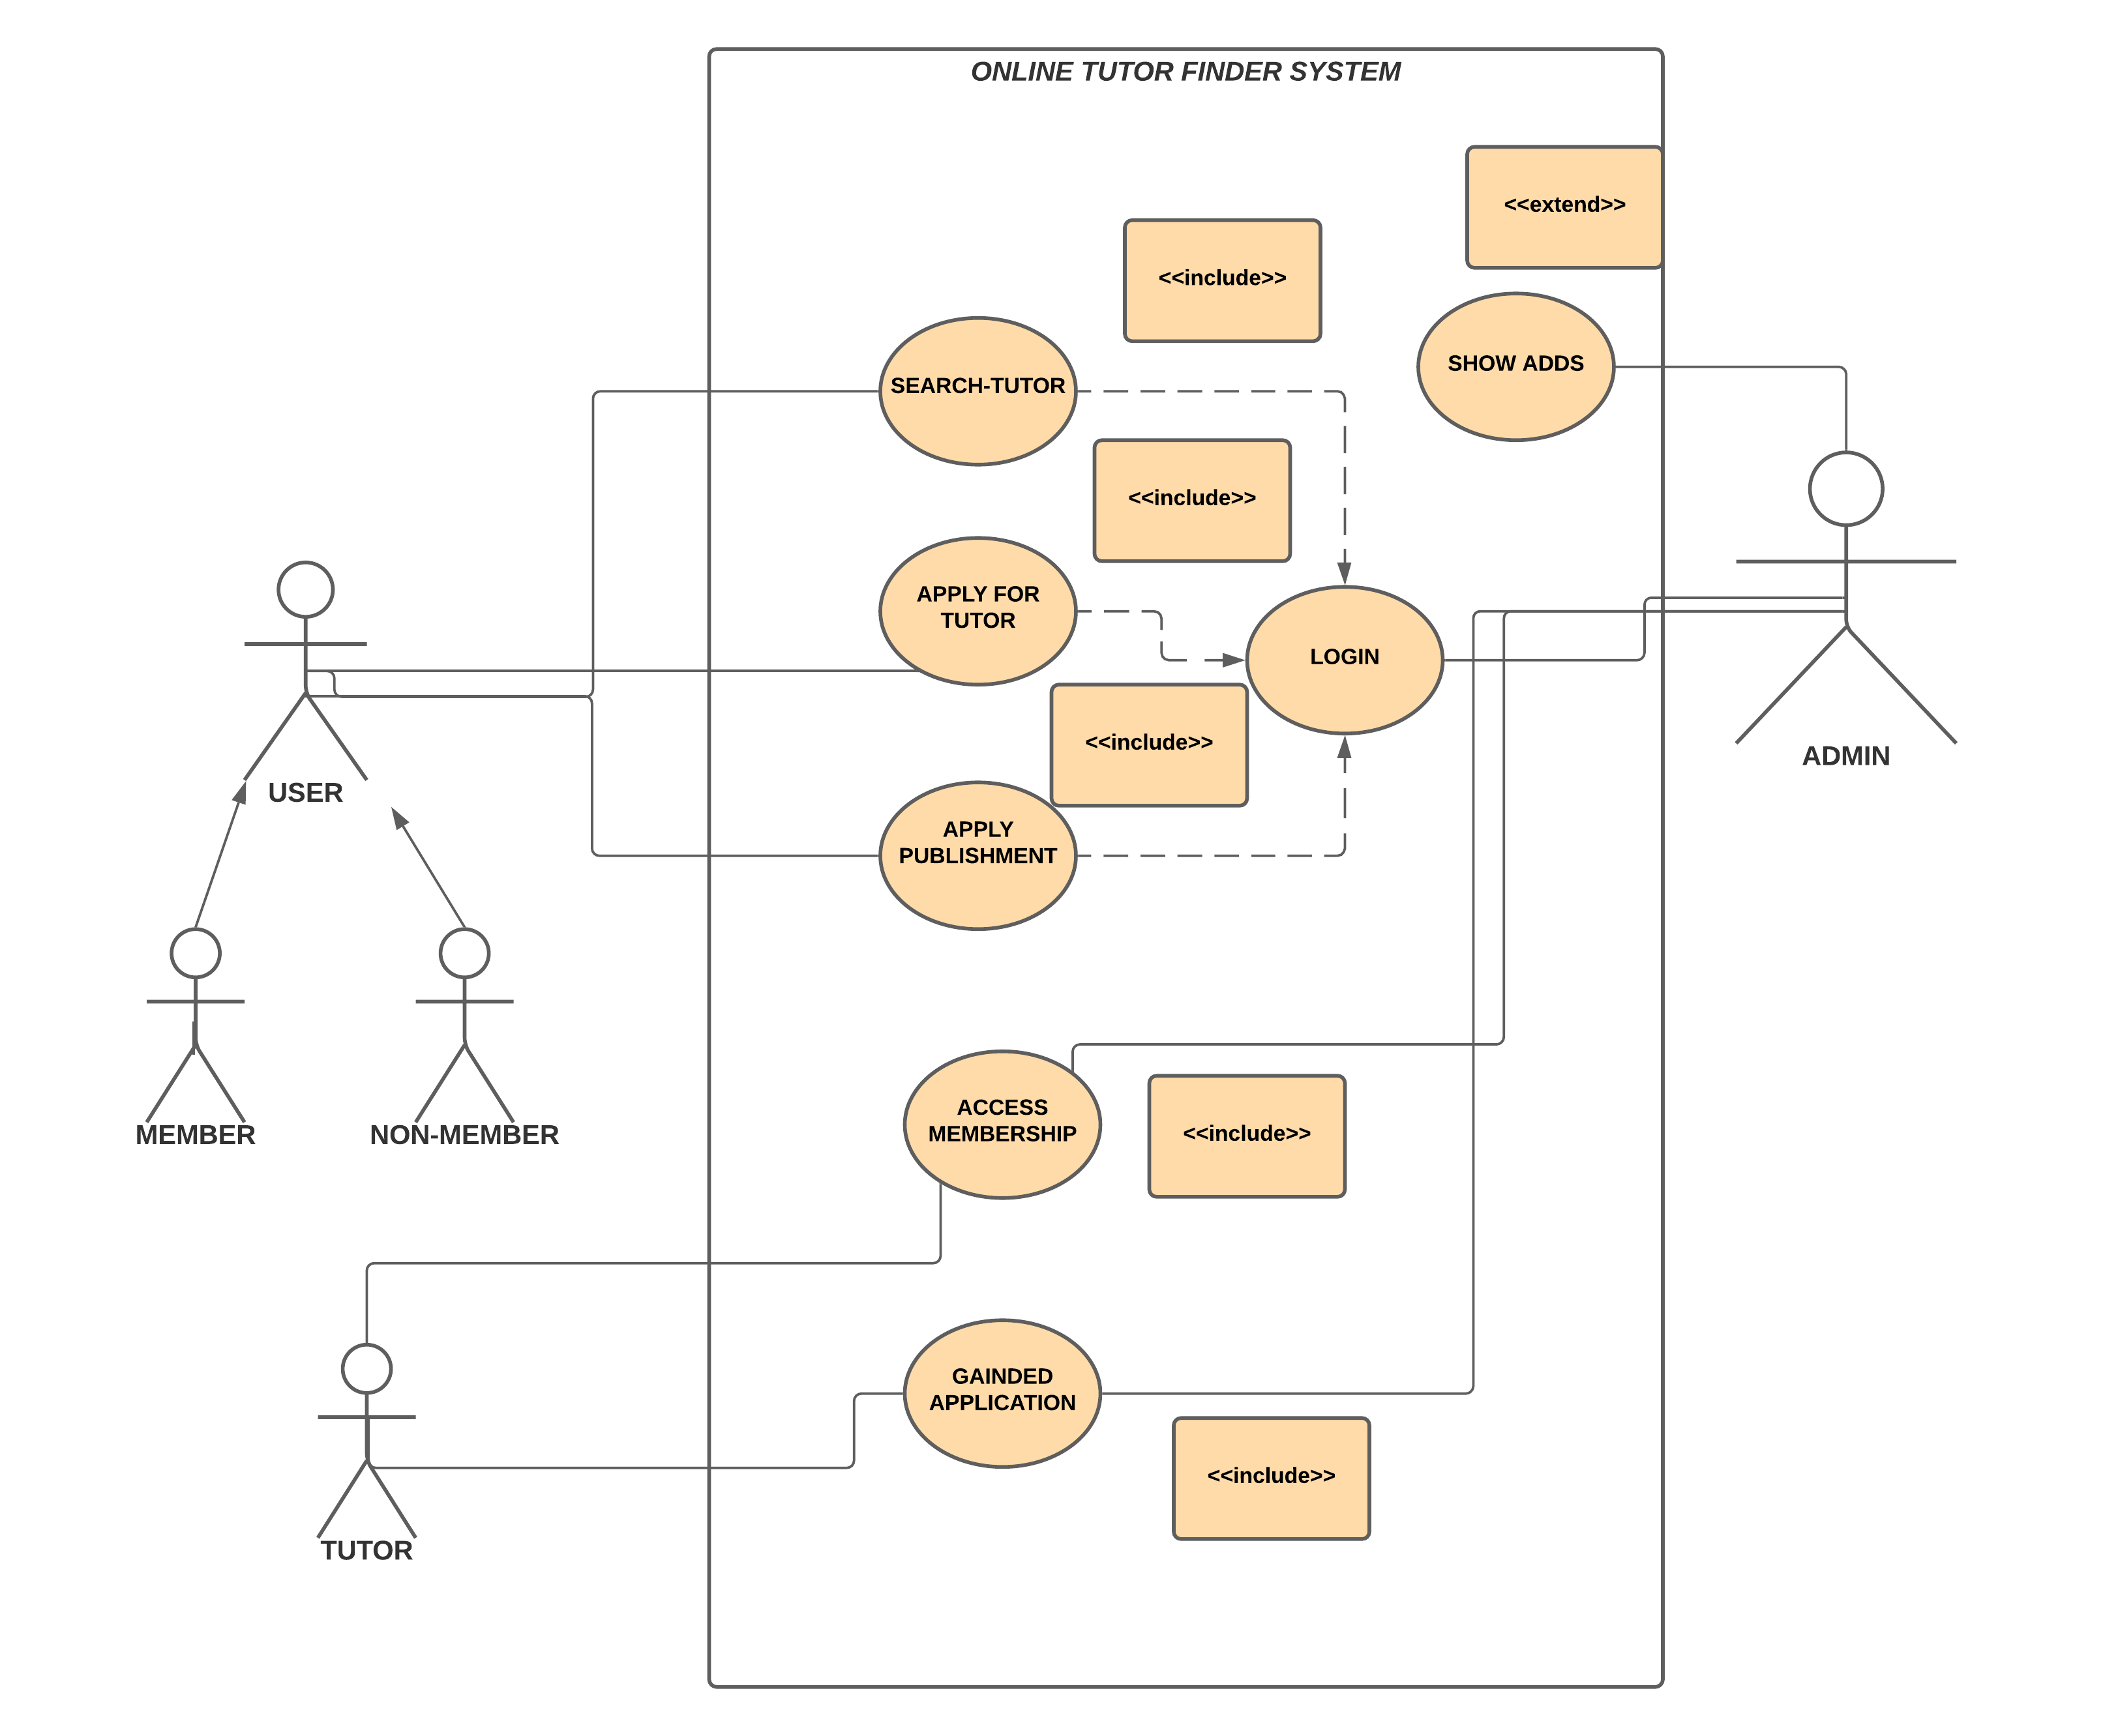
Methodology(Use-Case Diagram)

Slide 11
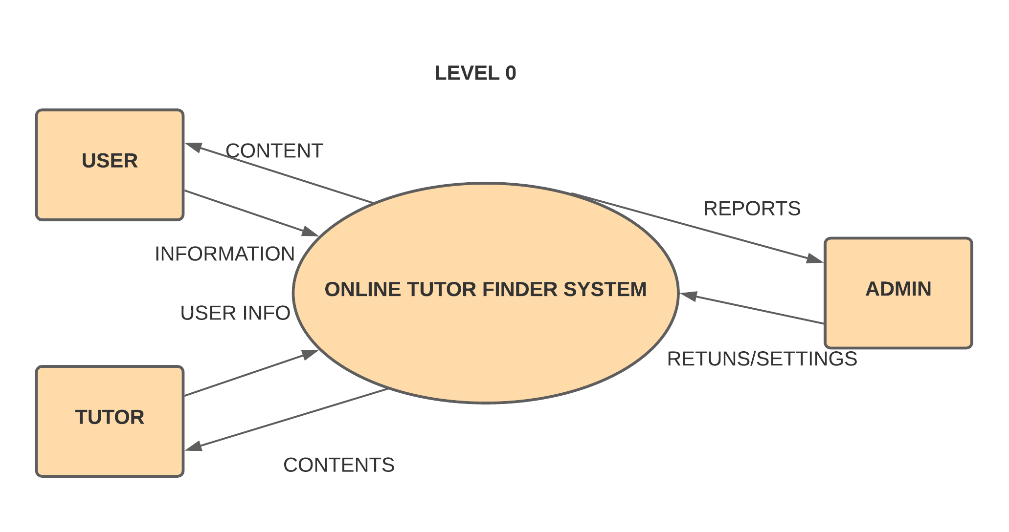
Methodology(Data flow Diagram)
0 LEVEL DIADRAM

Slide 12
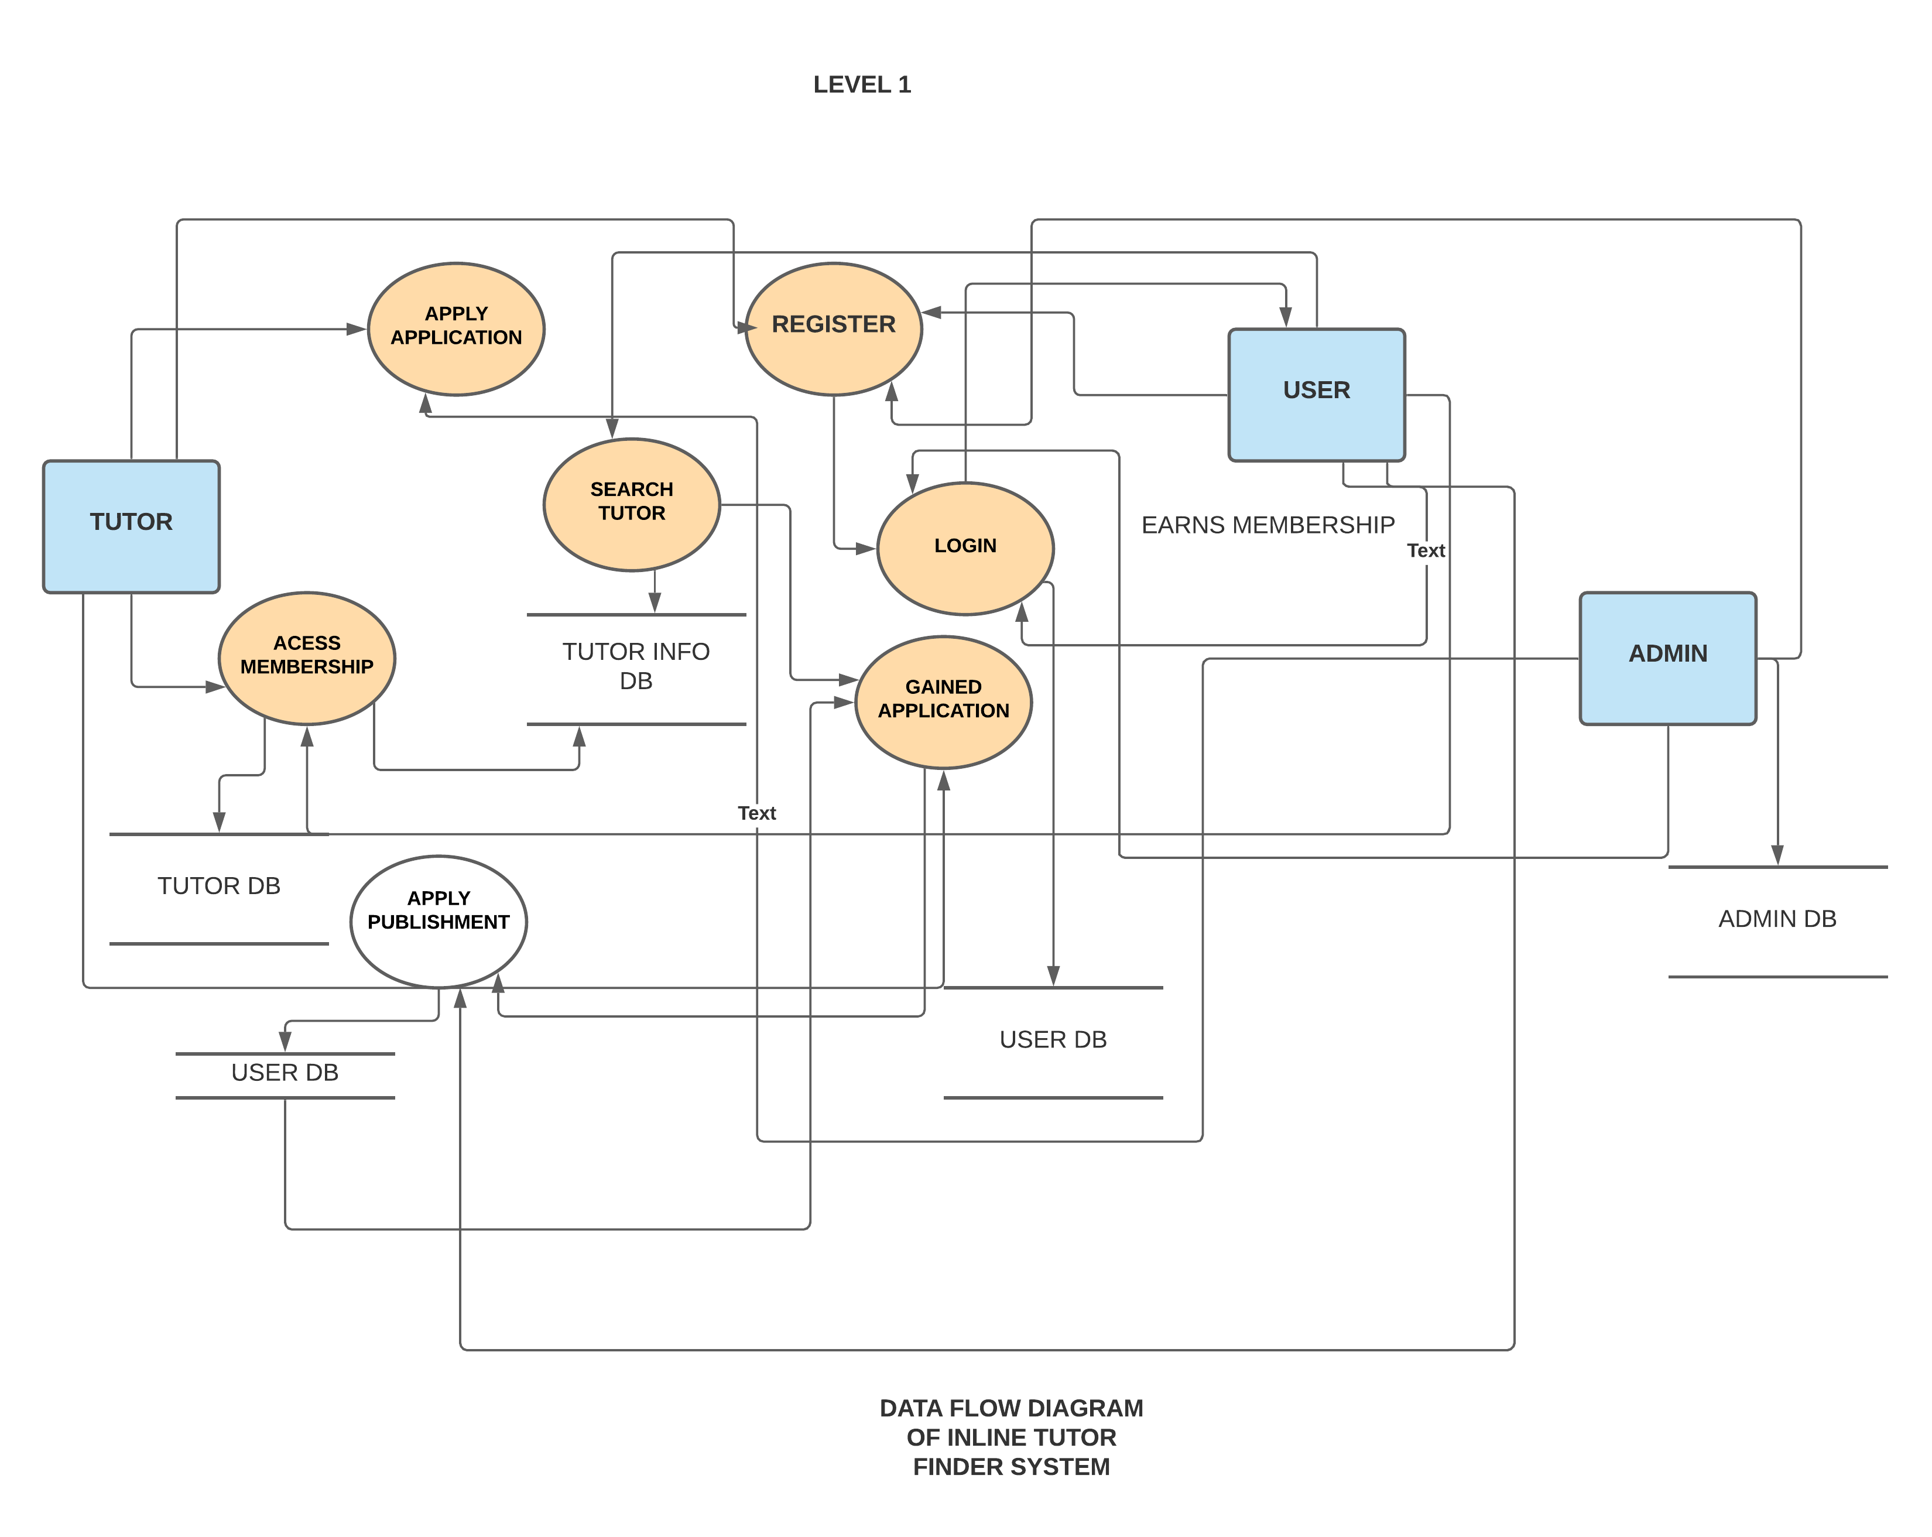
Methodology(Data flow Diagram)

Slide 13
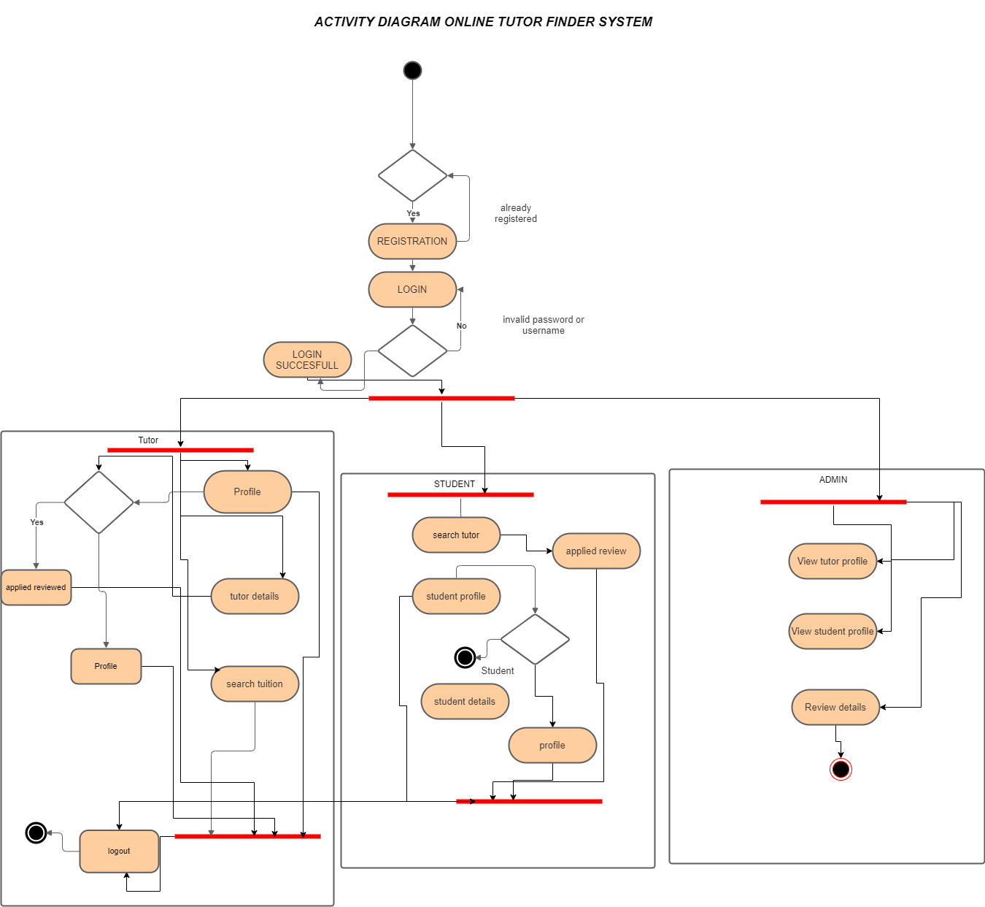
Methodology(Activity Diagram)

Slide 14
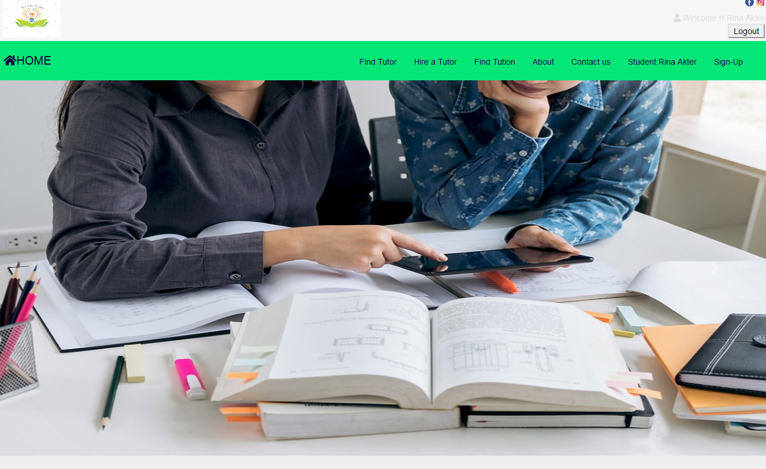
Features Used in OUR Project
HOME PAGE

Slide 15
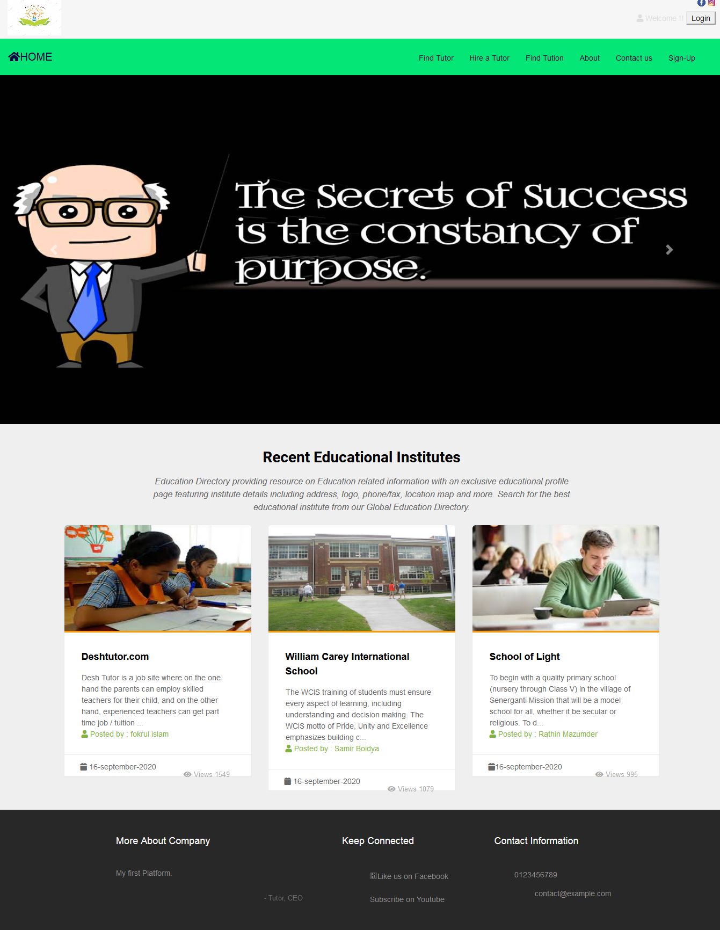
Features Used in OUR Project

Slide 16
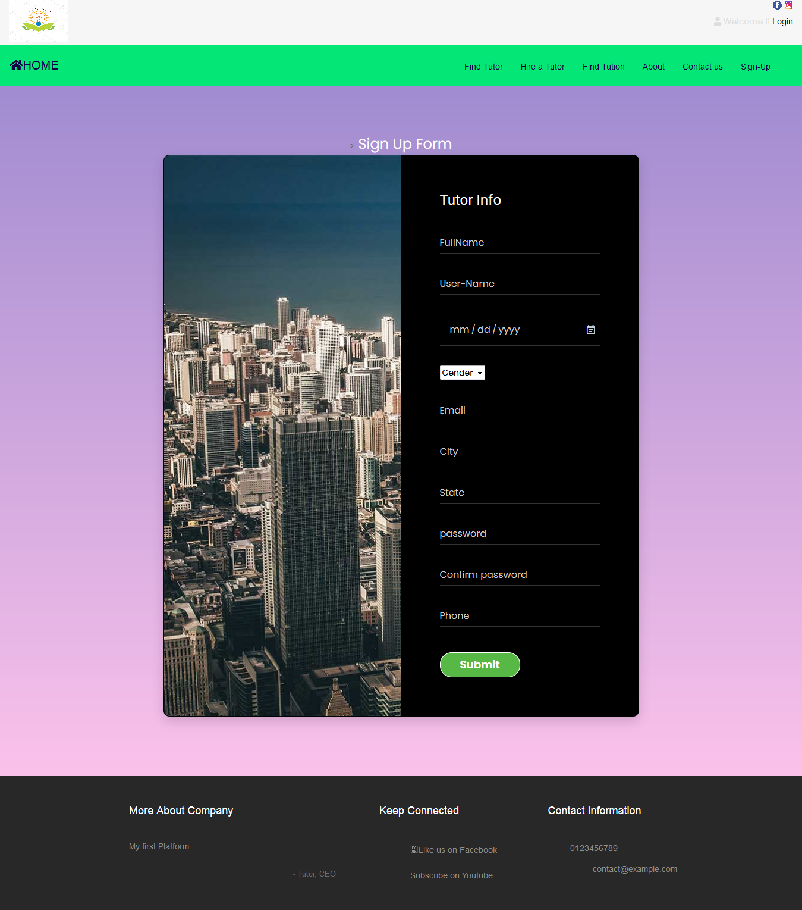
Features Used in OUR Project
SIGN UP FORM

Slide 17
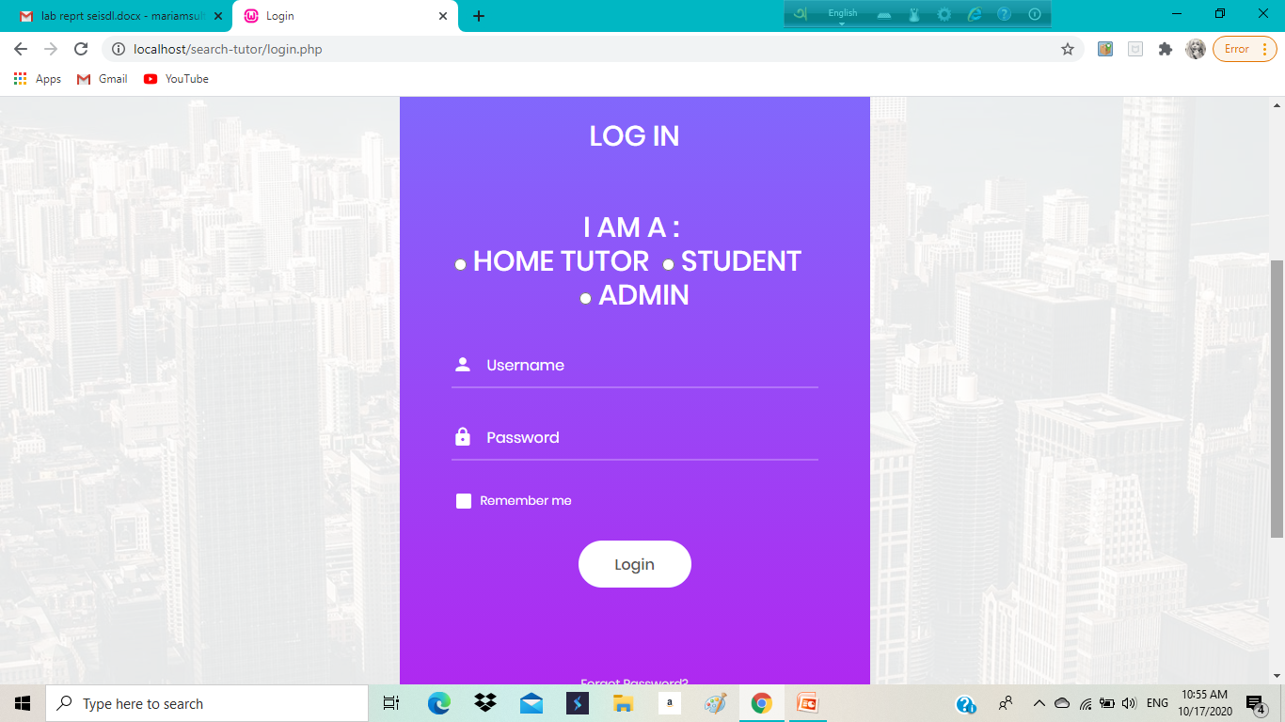
Features Used in OUR Project
LOGIN PAGE

Slide 18
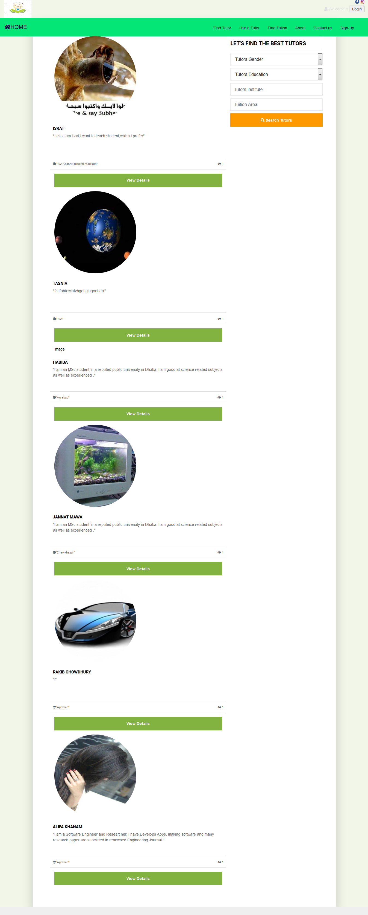
Features Used in OUR Project

Slide 19
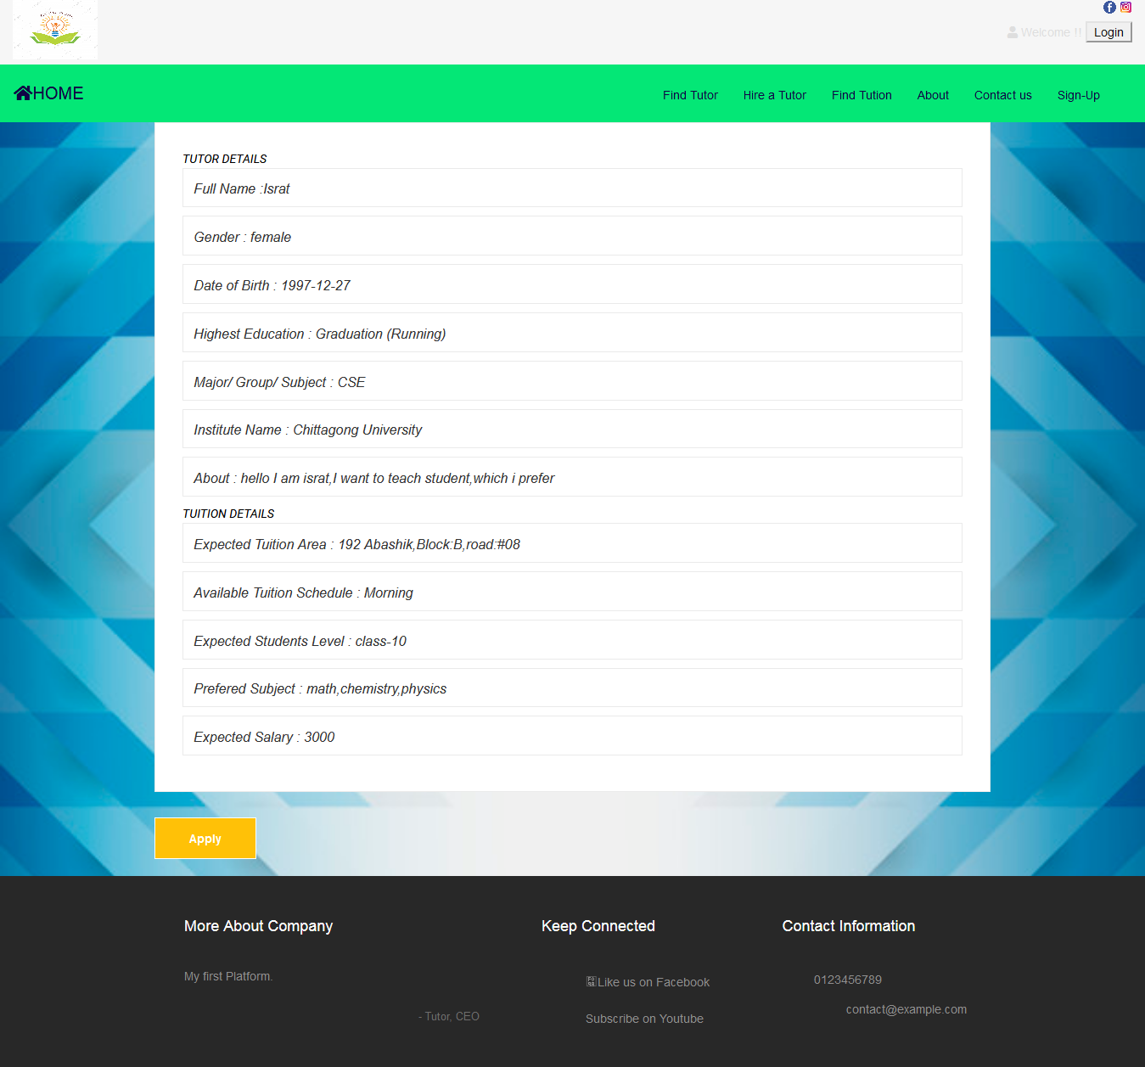
Features Used in OUR Project

Slide 20
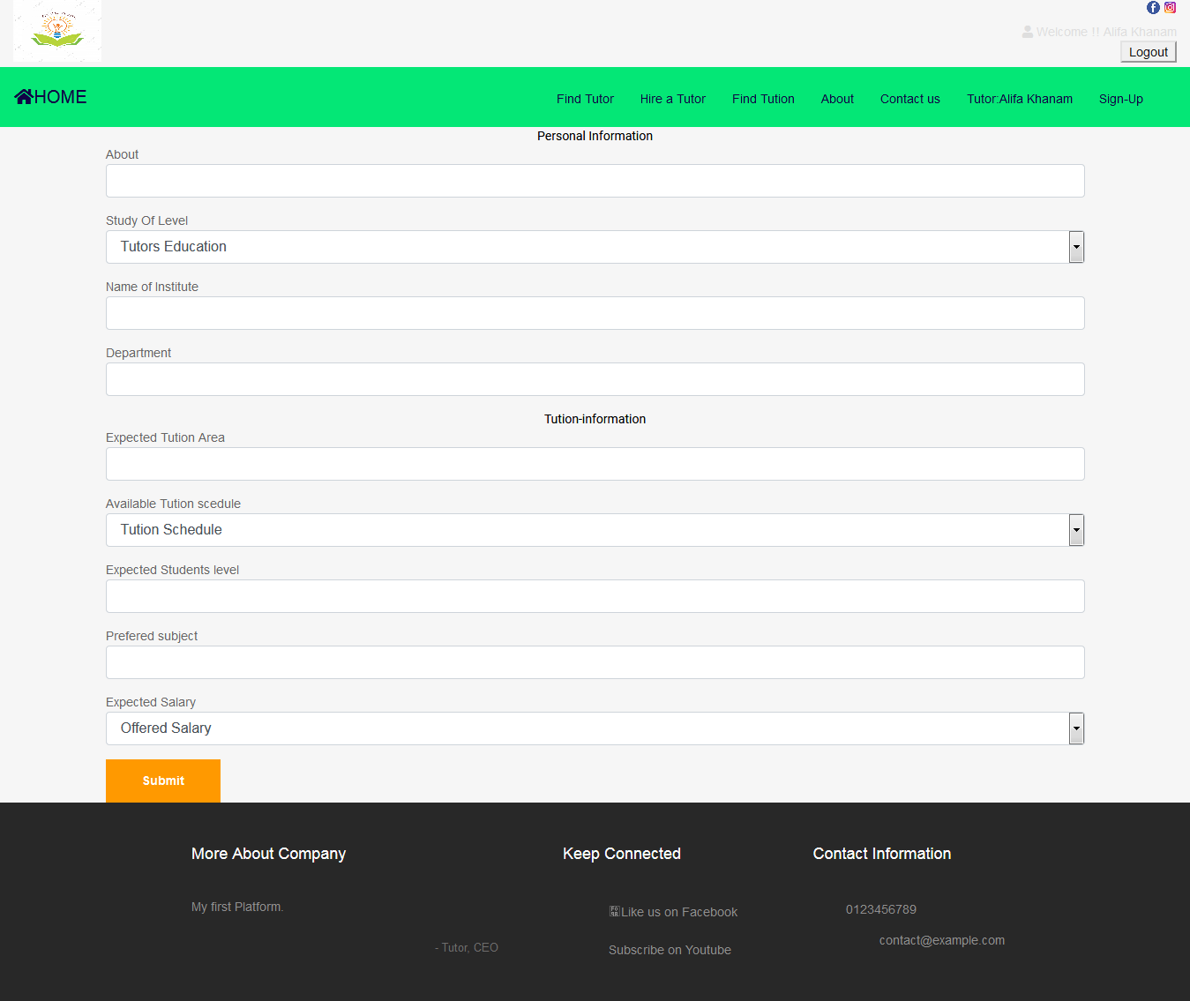
Features Used in OUR Project

Slide 21
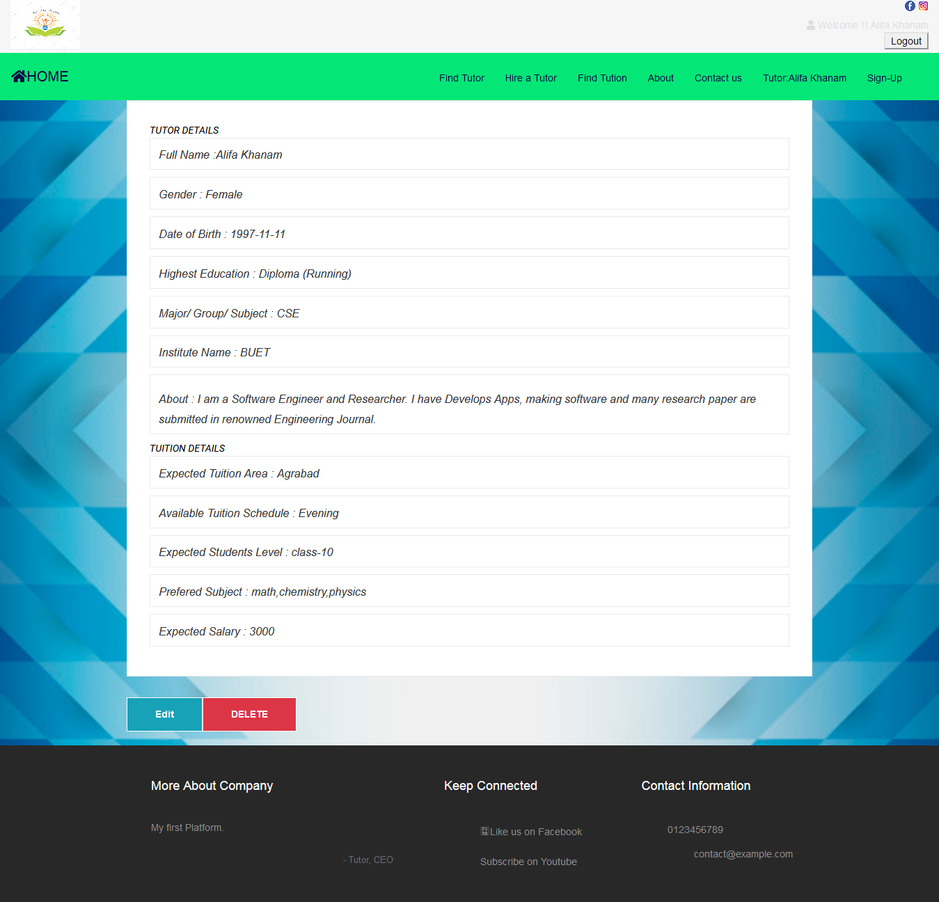
Features Used in OUR Project

Slide 22
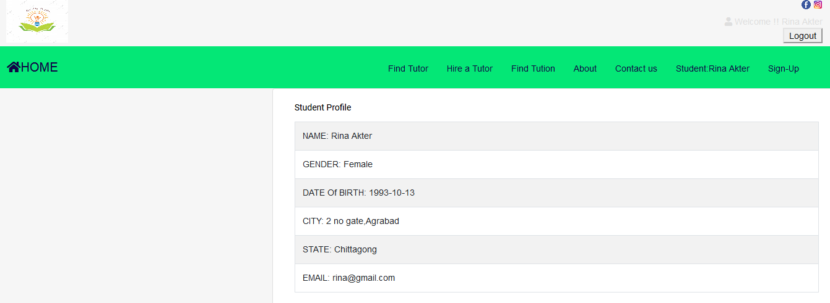
Features Used in OUR Project
STUDENT INFO

Slide 23
Features Used in OUR Project

Slide 24
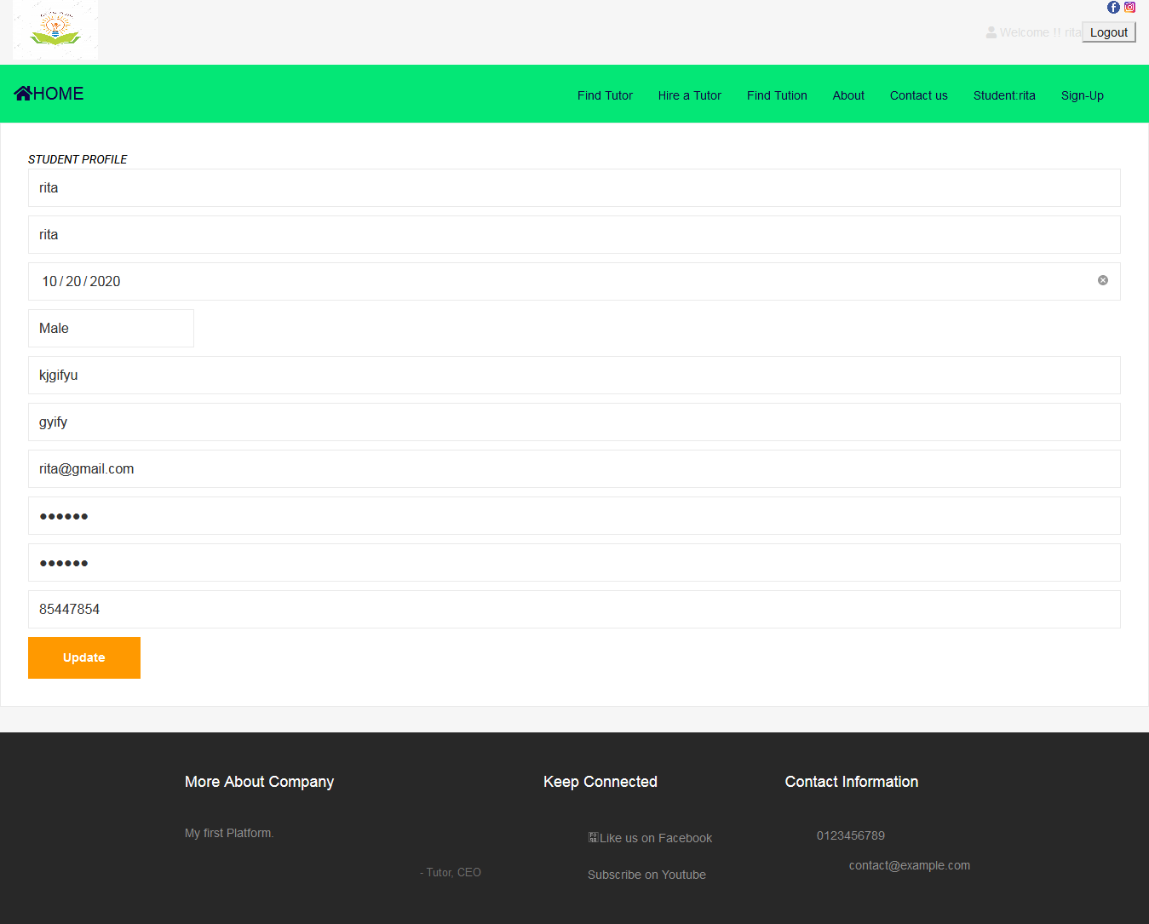
Features Used in OUR Project

Slide 25
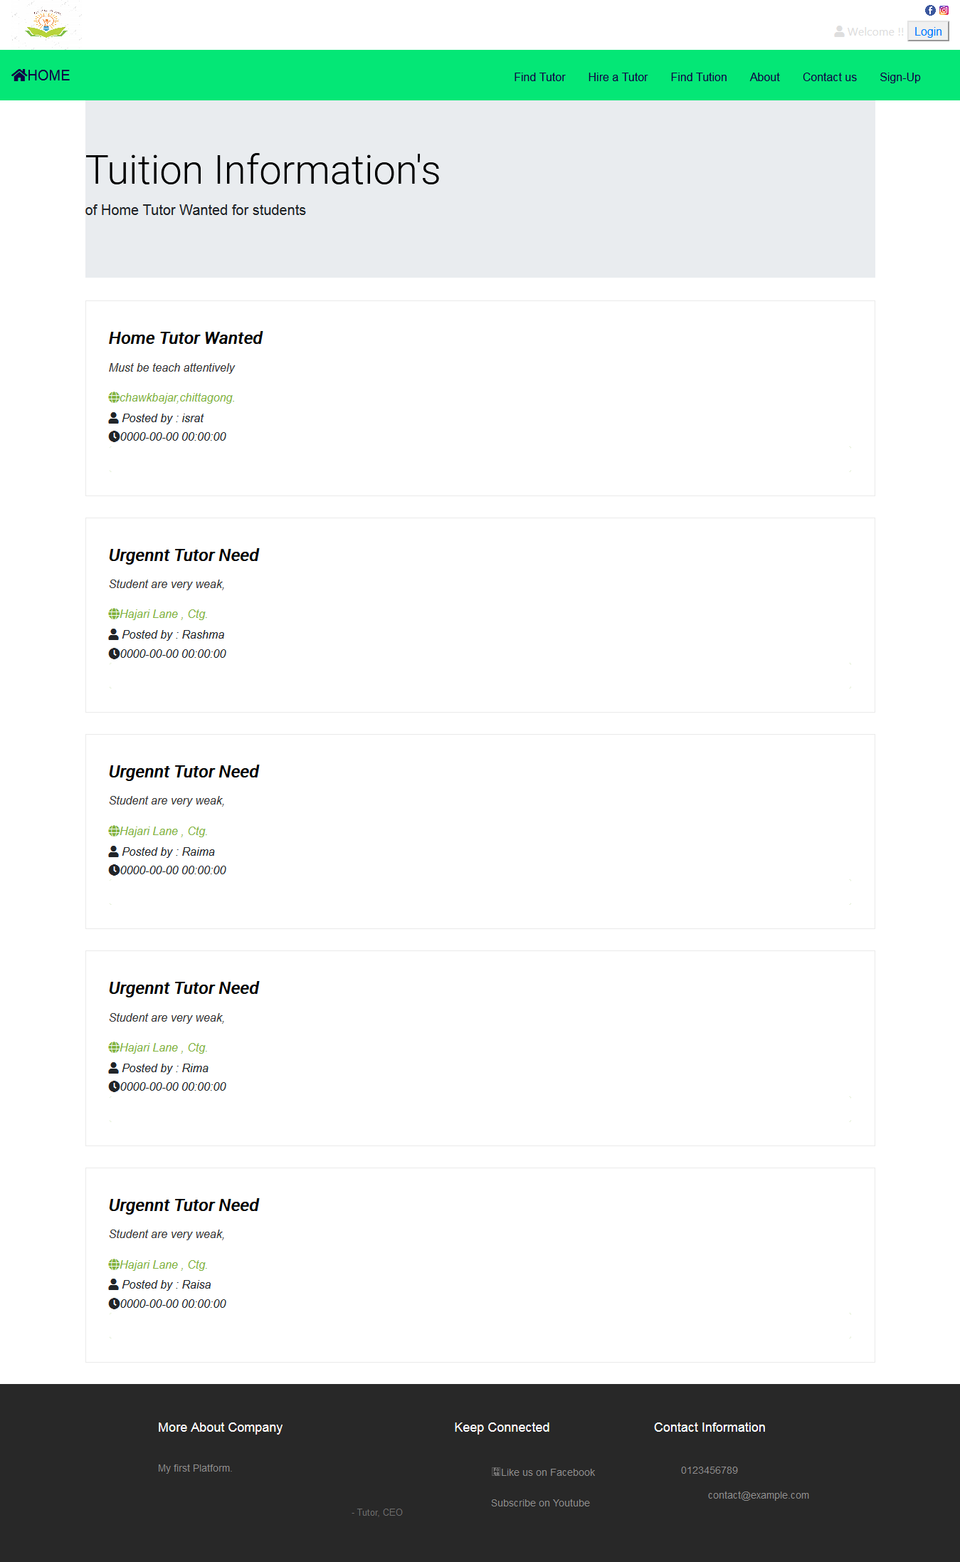
Features Used in OUR Project

Slide 26
Features Used in OUR Project

Slide 27
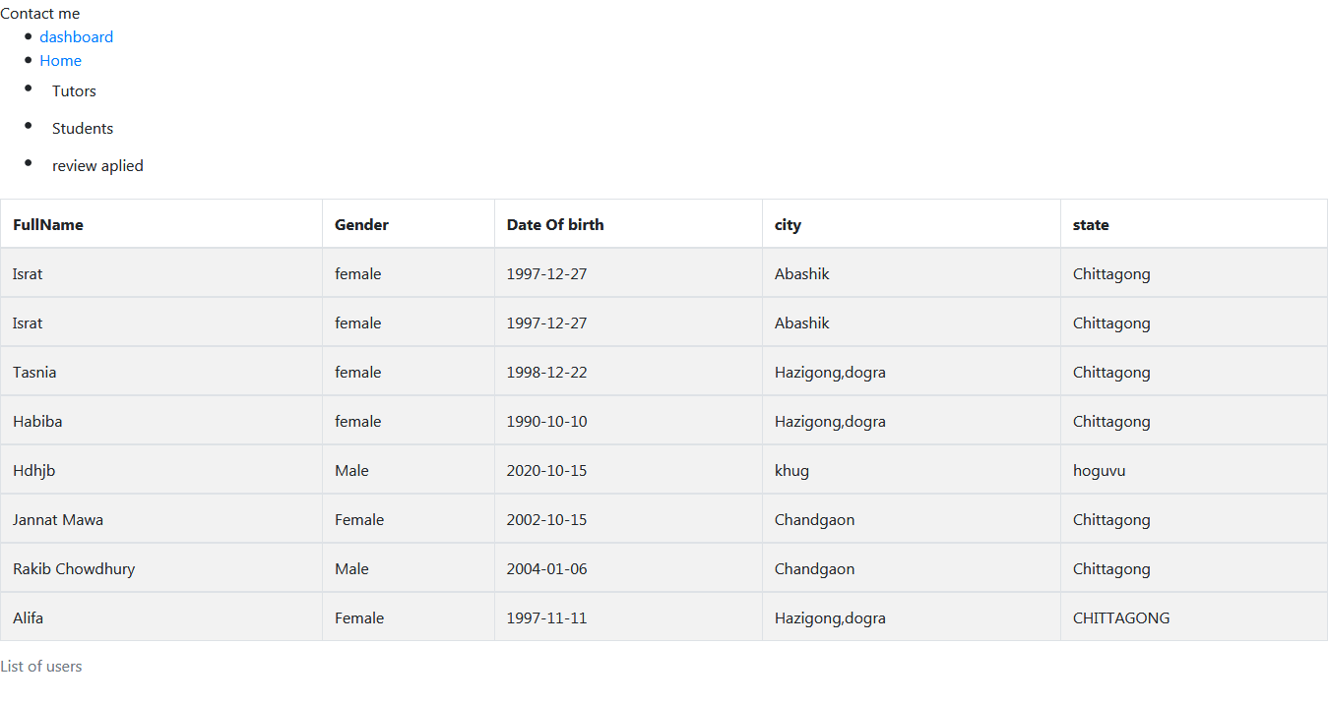
Features Used in OUR Project
DASHBOARD OF ADMIN

Slide 28
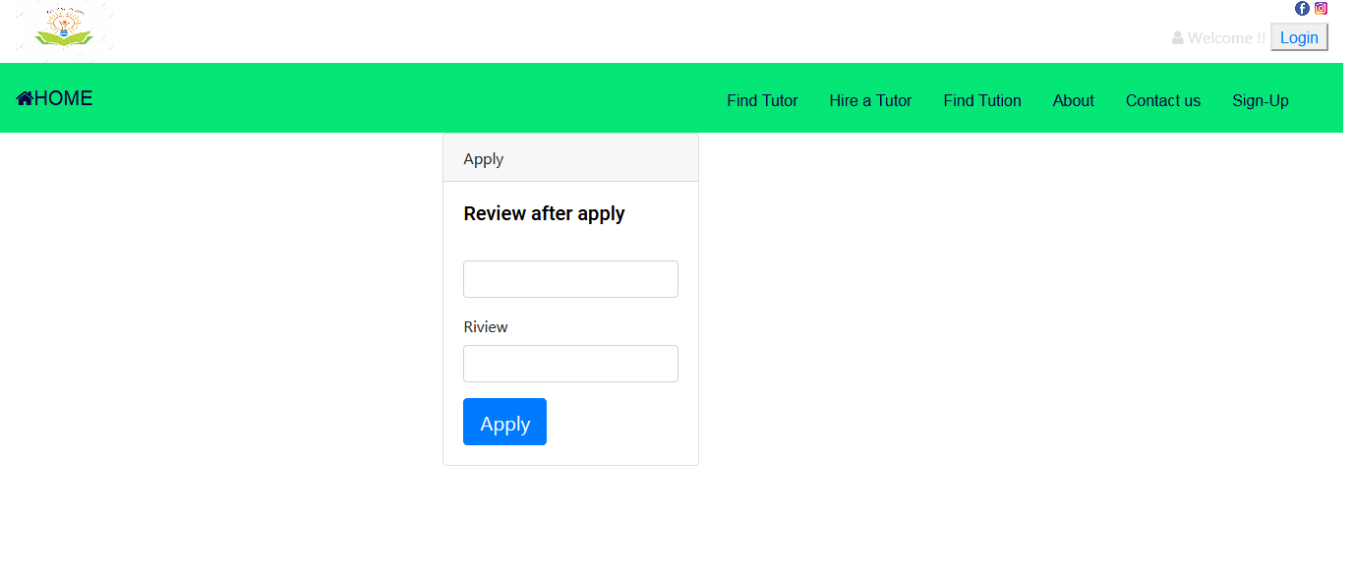
Features Used in OUR Project
REVIEW OF USER

Slide 29
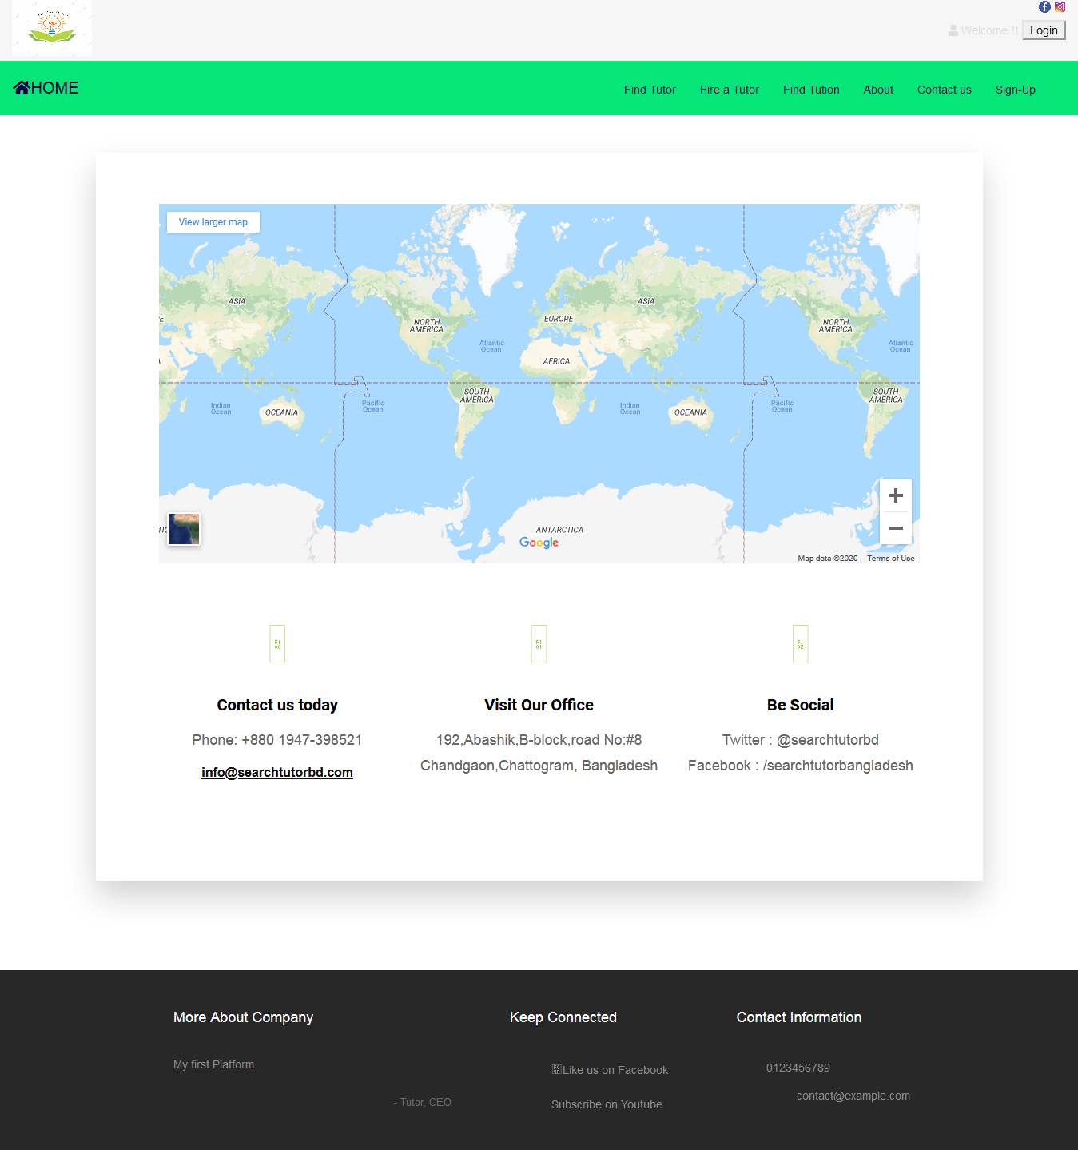
Features Used in OUR Project

Slide 30
Future Work
➢ Future work we can add also send notification each tutor and students.
➢ Admin can view advertisement
➢ We can also add online tutoring by payment system

Slide 31
Limitations
Can’t find teachers outside the country.
One must login to post publishment.
Can’t be connected with eachother
(tutor&student)without admin

Slide 32
Conclusion
Our real goal is to connect the tutor and student.
As all we know in this pandemic situation everyone has locked up in their residents. We are trying to make sure students studies doesn’t get hamperred due to CORONA.
In this way teacher can also get benefited through work from home.

Slide 33
Reference
https//:homtutorbd.com
https//:bdtutor.com

